Slide 1





資料庫系統報告
餐廳管理系統
第17組-胡晉嘉、張鈞凱、林震宇、楊政愷

Slide 2


目錄
應用情境 | 3
使用案例 | 4
系統需求說明 | 5
ER Diagram | 6
Schema | 8
SQL實作結果 | 28
View | 55
心得報告 | 63

Slide 3


應用情境
現代社會的人們更重視服務的效率與便利性，而我們為了提升顧客整體用餐體驗，同時簡化繁瑣的內部營運流程，決定製作一套全方位餐廳管理系統。這是一個完整的餐廳管理系統，適用於中小型餐廳或連鎖餐飲業者，整合了顧客管理、訂位訂餐、庫存管理、員工排班與財務記錄等功能。系統將幫助餐廳實現數位化轉型，提升營運效率與顧客服務品質。

Slide 4
使用案例
員工
（店員與廚房人員）
顧客
管理者
註冊與登入
線上預約座位
瀏覽菜單並點餐
線上訂單與外送
付款與結帳
登入系統與身份辨識
查看訂位與訂單資訊
接收廚房點餐通知
打卡上下班與出勤記錄
使用者與員工管理
庫存與進貨管理
查看營運報表

Slide 5




系統需求說明
庫存預警:即時監控庫存數量，當庫存低於安全存量時自動觸發預警 今日訂單總覽:即時顯示當日所有訂單狀態的綜合儀表 菜單總覽:顯示所有菜單 熱門菜單項目:分析並顯示最受歡迎的餐點項目 每月銷售報表:完整呈現月度銷售績效的綜合報表 待處理訂位:集中管理所有訂位請求 員工月出勤時數:計算並分析員工每月工作時數 待處理訂單:廚房與外場協同作業的訂單處理中心

Slide 6






ER圖

Slide 7
ER圖
user_id
staff_id
position
salary
hire_date
table_id
N
1
username
user_id
status
Attend By
Staff
Attendance
Account
password
reservation_id
reservation_time
1
attendance_id
staff_id
check_
in_time
check_
out_time
1
user_id
Reservations
Belongs To
login to
N
1
1
N
1
Reserve
payment_
status
payment_id
payment_
method
Users
1
Made By
1
payment_
time
order_id
1
created_
time
Table
Payments
name
role
Made By
table_id
table_
number
capacity
status
1
Made By
email
phone_
number
N
user_id
supplier_id
N
contact_info
Made By
Inventory
1
N
Suppliers
Provide By
address
order_time
inventory_id
item_name
stock_quantity
supplier_id
supplier_
name
1
total_price
Orders
1
Contains
N
Order_Items
N
item_id
price
category_id
Is
order_status
1
category_
name
Menu_Items
1
Belongs To
N
Menu_
Categories
category_id
order_id
user_id
table_id
order_
item_id
order_id
item_id
quantity
description
item_name
availability

Slide 8
Schema

Slide 9
Schema
Users(使用者)
欄位名稱 | 資料型態 | 是否為null | 完整性限制
user_id | INT UNSIGNED | NOT NULL | 範圍為 '1' 到'4,294,967,295'，每次創建新資料時自動 +1 遞增
name | VARCHAR(100) | NOT NULL | 最多 100 字元，超過長度將無法儲存
email | VARCHAR(100) | NULL | 最多 100 字元，需為唯一值，必須有@，超過長度將無法儲存
phone_ number | VARCHAR(10) | NOT NULL | 共10字元，前兩位數字 必須是'09'後八位數字可 以是從'00000000'到 '99999999'的任意組合 ，如'0912345678'
CREATE TABLE Users (
user_id INT UNSIGNED NOT NULL AUTO_INCREMENT,
name VARCHAR(100) NOT NULL,
email VARCHAR(100) UNIQUE,
phone_number VARCHAR(10) NOT NULL
CHECK (phone_number LIKE '09________'),
role ENUM('Customer', 'Staff ', 'Admin')
NOT NULL,
created_time TIMESTAMP DEFAULT CURRENT_TIMESTAMP,
PRIMARY KEY (user_id)
);

Slide 10
Schema
Users
欄位名稱 | 資料型態 | 是否為null | 完整性限制
role | ENUM('Customer','Staff','Manager','Admin') | NOT NULL | 列舉型別，限定為：Customer、Staff、Admin，不可填入其他未定義的值
created_time | TIMESTAMP | NOT NULL | 時間格式，預設為系統目前時間（CURRENT_TIMESTAMP）
Users(使用者)
CREATE TABLE Users (
user_id INT UNSIGNED NOT NULL AUTO_INCREMENT,
name VARCHAR(100) NOT NULL,
email VARCHAR(100) UNIQUE,
phone_number VARCHAR(10) NOT NULL
CHECK (phone_number LIKE '09________'),
role ENUM('Customer', 'Staff ', 'Admin')
NOT NULL,
created_time TIMESTAMP DEFAULT CURRENT_TIMESTAMP,
PRIMARY KEY (user_id)
);

Slide 11
Schema
Accounts(帳號)
欄位名稱 | 資料型態 | 是否為null | 完整性限制
account_id | INT UNSIGNED | NOT NULL | 範圍為 '1' 到'4,294,967,295'，每次創建新資料時自動 +1 遞增
user_id | INT UNSIGNED | NOT NULL | 參照 Users(user_id)，刪除時級聯刪除
username | VARCHAR(100) | NOT NULL | 此欄位值需為唯一，不能與其他紀錄重複，系統將強制檢查， 最多 100 字元
password | VARCHAR(64) | NOT NULL | 以安全演算法SHA-256加密處理的密碼雜湊值，由英數組合長度為 255 字元，避免儲存明文密碼
CREATE TABLE Accounts (
account_id INT UNSIGNED NOT NULL AUTO_INCREMENT,
user_id INT UNSIGNED NOT NULL,
username VARCHAR(100) NOT NULL UNIQUE,
password VARCHAR(64) NOT NULL,
PRIMARY KEY (account_id),
FOREIGN KEY (user_id) REFERENCES Users(user_id) ON DELETE CASCADE
);

Slide 12
Schema
Tables(桌子)
欄位名稱 | 資料型態 | 是否為null | 完整性限制
table_id | INT UNSIGNED | NOT NULL | 範圍為 '1' 到'4,294,967,295'，每次創建新資料時自動 +1 遞增
table_number | INT UNSIGNED | NOT NULL | 必須大於 0，上限100，系統會檢查此條件以確保有效數值
capacity | INT UNSIGNED | NOT NULL | 必須大於 0，上限100，系統會檢查此條件以確保有效數值
status | ENUM('Available','Occupied','Reserved') | NOT NULL | 列舉型別，限定為：Available、Occupied、Reserved，不可填入其他未定義的值
CREATE TABLE Tables (
table_id INT UNSIGNED NOT NULL AUTO_INCREMENT,
table_number INT UNSIGNED NOT NULL CHECK (table_number > 0 AND table_number <= 100),
capacity INT UNSIGNED NOT NULL CHECK (capacity > 0 AND capacity <= 100),
status ENUM('Available', 'Occupied', 'Reserved') NOT NULL,
PRIMARY KEY (table_id)
);

Slide 13
Schema
Reservations (訂位)
欄位名稱 | 資料型態 | 是否為null | 完整性限制
reservation_id | INT UNSIGNED | NOT NULL | 範圍為 '1' 到'4,294,967,295'，每次創建新資料時自動 +1 遞增
user_id | INT UNSIGNED | NOT NULL | 參照 Users(user_id)
table_id | INT UNSIGNED | NOT NULL | 參照 Tables(table_id)
reservation_time | DATETIME | NOT NULL | 標準時間格式，需符合 YYYY-MM-DD HH:MM:SS 格式
CREATE TABLE Reservations (
reservation_id INT UNSIGNED NOT NULL AUTO_INCREMENT,
user_id INT UNSIGNED NOT NULL,
table_id INT UNSIGNED NOT NULL,
reservation_time DATETIME NOT NULL,
status ENUM('Pending', 'Confirmed', 'Cancelled') NOT NULL,
PRIMARY KEY (reservation_id),
FOREIGN KEY (user_id) REFERENCES Users(user_id),
FOREIGN KEY (table_id) REFERENCES Tables(table_id)
);

Slide 14
Schema
Reservations (訂位)
欄位名稱 | 資料型態 | 是否為null | 完整性限制
status | ENUM('Pending','Confirmed','Cancelled') | NOT NULL | 列舉型別，限定為：Pending、Confirmed、Cancelled，不可填入其他未定義的值
CREATE TABLE Reservations (
reservation_id INT UNSIGNED NOT NULL AUTO_INCREMENT,
user_id INT UNSIGNED NOT NULL,
table_id INT UNSIGNED NOT NULL,
reservation_time DATETIME NOT NULL,
status ENUM('Pending', 'Confirmed', 'Cancelled') NOT NULL,
PRIMARY KEY (reservation_id),
FOREIGN KEY (user_id) REFERENCES Users(user_id),
FOREIGN KEY (table_id) REFERENCES Tables(table_id)
);

Slide 15
Schema
Menu_Categories
(菜單類別)
欄位名稱 | 資料型態 | 是否為null | 完整性限制
category_id | ENUM('Pending','Confirmed','Cancelled') | NOT NULL | 列舉型別，限定為：Pending、Confirmed、Cancelled，不可填入其他未定義的值
category_name | VARCHAR(100) | NOT NULL | 最多 100 字元，超過長度將無法儲存
CREATE TABLE Menu_Categories (
category_id INT UNSIGNED NOT NULL AUTO_INCREMENT,
category_name VARCHAR(100) NOT NULL,
PRIMARY KEY (category_id)
);

Slide 16
Schema
Menu_Items(菜單品項)
欄位名稱 | 資料型態 | 是否為null | 完整性限制
item_id | INT UNSIGNED | NOT NULL | 範圍為 '1' 到'4,294,967,295'，每次創建新資料時自動 +1 遞增
category_id | INT UNSIGNED | NOT NULL | 最多 100 字元，超過長度將無法儲存
item_name | VARCHAR(20) | NOT NULL | 參照 Tables(table_id)
description | VARCHAR(100) | YES | 最多 100 字元，超過長度將無法儲存
CREATE TABLE Menu_Items (
item_id INT UNSIGNED NOT NULL AUTO_INCREMENT,
category_id INT UNSIGNED NOT NULL,
item_name VARCHAR(20) NOT NULL,
description VARCHAR(100),
price INT UNSIGNED NOT NULL CHECK (price > 0),
availability ENUM('Available', 'Out of Stock') NOT NULL,
PRIMARY KEY (item_id),
FOREIGN KEY (category_id) REFERENCES Menu_Categories(category_id)
);

Slide 17
Schema
Menu_Items(菜單品項)
欄位名稱 | 資料型態 | 是否為null | 完整性限制
price | INT UNSIGNED | NOT NULL | 必須大於 0
availability | ENUM('Available','Out of Stock') | NOT NULL | 列舉型別，限定為：Available、Out of Stock，不可填入其他未定義的值
CREATE TABLE Menu_Items (
item_id INT UNSIGNED NOT NULL AUTO_INCREMENT,
category_id INT UNSIGNED NOT NULL,
item_name VARCHAR(100) NOT NULL,
description TEXT,
price INT UNSIGNED NOT NULL CHECK (price > 0),
availability ENUM('Available', 'Out of Stock') NOT NULL,
PRIMARY KEY (item_id),
FOREIGN KEY (category_id) REFERENCES Menu_Categories(category_id)
);

Slide 18
Schema
Orders (訂單)
欄位名稱 | 資料型態 | 是否為null | 完整性限制
order_id | INT UNSIGNED | NOT NULL | 範圍為 '1' 到'4,294,967,295'，每次創建新資料時自動 +1 遞增
user_id | INT UNSIGNED | NOT NULL | 參照 Users(user_id)
table_id | INT UNSIGNED | NOT NULL | 參照 Tables(table_id)
order_status | ENUM('Pending','In Progress','Completed','Cancelled') | NOT NULL | 列舉型別，限定為：Pending、In Progress、Completed、Cancelled，不可填入其他未定義的值
CREATE TABLE Orders (
order_id INT UNSIGNED NOT NULL AUTO_INCREMENT,
user_id INT UNSIGNED NOT NULL,
table_id INT UNSIGNED NOT NULL,
order_status ENUM('Pending', 'In Progress', 'Completed', 'Cancelled') NOT NULL,
order_time TIMESTAMP DEFAULT CURRENT_TIMESTAMP,
total_price INT UNSIGNED NOT NULL CHECK (total_price >= 0),
PRIMARY KEY (order_id),
FOREIGN KEY (user_id) REFERENCES Users(user_id),
FOREIGN KEY (table_id) REFERENCES Tables(table_id)
);

Slide 19
Schema
Orders (訂單)
欄位名稱 | 資料型態 | 是否為null | 完整性限制
order_time | TIMESTAMP | NOT NULL | 時間格式，預設為系統目前時間（CURRENT_TIMESTAMP）
total_price | INT UNSIGNED | NOT NULL | 不得為負
CREATE TABLE Orders (
order_id INT UNSIGNED NOT NULL AUTO_INCREMENT,
user_id INT UNSIGNED NOT NULL,
table_id INT UNSIGNED,
order_status ENUM('Pending', 'In Progress', 'Completed', 'Cancelled') NOT NULL,
order_time TIMESTAMP DEFAULT CURRENT_TIMESTAMP,
total_price INT UNSIGNED NOT NULL CHECK (total_price >= 0),
PRIMARY KEY (order_id),
FOREIGN KEY (user_id) REFERENCES Users(user_id),
FOREIGN KEY (table_id) REFERENCES Tables(table_id)
);

Slide 20
Schema
Order_Items(訂單品項)
欄位名稱 | 資料型態 | 是否為null | 完整性限制
order_item_id | INT UNSIGNED | NOT NULL | 範圍為 '1' 到'4,294,967,295'，每次創建新資料時自動 +1 遞增
order_id | INT UNSIGNED | NOT NULL | 參照 Orders(order_id)
item_id | INT UNSIGNED | NOT NULL | 參照 Menu_Items(item_id)
quantity | INT UNSIGNED | NOT NULL | 必須大於 0
CREATE TABLE Order_Items (
order_item_id INT UNSIGNED NOT NULL AUTO_INCREMENT,
order_id INT UNSIGNED NOT NULL,
item_id INT UNSIGNED NOT NULL,
quantity INT UNSIGNED NOT NULL CHECK (quantity > 0),
PRIMARY KEY (order_item_id),
FOREIGN KEY (order_id) REFERENCES Orders(order_id),
FOREIGN KEY (item_id) REFERENCES Menu_Items(item_id)
);

Slide 21
Schema
Payments (付款方式)
欄位名稱 | 資料型態 | 是否為null | 完整性限制
payment_id | INT UNSIGNED | NOT NULL | 範圍為 '1' 到'4,294,967,295'，每次創建新資料時自動 +1 遞增
order_id | INT UNSIGNED | NOT NULL | 參照 Orders(order_id)
payment_ method | ENUM('Cash','Credit Card','online payment') | NOT NULL | 列舉型別，限定為：Cash、Credit Card、online payment，不可填入其他未定義的值
payment_ status | ENUM('Paid','Pending','Failed') | NOT NULL | 列舉型別，限定為：Paid、Pending、Failed，不可填入其他未定義的值
CREATE TABLE Payments (
payment_id INT UNSIGNED NOT NULL AUTO_INCREMENT,
order_id INT UNSIGNED NOT NULL,
payment_method ENUM('Cash', 'Credit Card', 'online payment') NOT NULL,
payment_status ENUM('Paid', 'Pending', 'Failed') NOT NULL,
payment_time TIMESTAMP DEFAULT CURRENT_TIMESTAMP,
PRIMARY KEY (payment_id),
FOREIGN KEY (order_id) REFERENCES Orders(order_id)
);

Slide 22
Schema
Payments
欄位名稱 | 資料型態 | 是否為null | 完整性限制
payment_time | TIMESTAMP | NOT NULL | 時間格式，預設為系統目前時間（CURRENT_TIMESTAMP）
Payments (付款方式)
CREATE TABLE Payments (
payment_id INT UNSIGNED NOT NULL AUTO_INCREMENT,
order_id INT UNSIGNED NOT NULL,
payment_method ENUM('Cash', 'Credit Card', 'online payment') NOT NULL,
payment_status ENUM('Paid', 'Pending', 'Failed') NOT NULL,
payment_time TIMESTAMP DEFAULT CURRENT_TIMESTAMP,
PRIMARY KEY (payment_id),
FOREIGN KEY (order_id) REFERENCES Orders(order_id)
);

Slide 23
Schema
Staff (員工)
欄位名稱 | 資料型態 | 是否為null | 完整性限制
staff_id | INT UNSIGNED | NOT NULL | 範圍為 '1' 到'4,294,967,295'，每次創建新資料時自動 +1 遞增
user_id | INT UNSIGNED | NOT NULL | 參照 Users(user_id)
position | ENUM('Waiter','Chef','Manager') | NOT NULL | 列舉型別，限定為：Waiter、Chef、Manager，不可填入其他未定義的值
salary | INT UNSIGNED | NOT NULL | 整數型別，必須大於 0
CREATE TABLE Staff (
staff_id INT UNSIGNED NOT NULL AUTO_INCREMENT,
user_id INT UNSIGNED NOT NULL,
position ENUM('Waiter', 'Chef', 'Manager') NOT NULL,
salary INT NOT NULL CHECK (salary > 0),
hire_date TIMESTAMP DEFAULT CURRENT_TIMESTAMP,
PRIMARY KEY (staff_id),
FOREIGN KEY (user_id) REFERENCES Users(user_id)
);

Slide 24
Schema
Staff (員工)
欄位名稱 | 資料型態 | 是否為null | 完整性限制
hire_date | TIMESTAMP | NOT NULL | 時間格式，預設為系統目前時間（CURRENT_TIMESTAMP）
CREATE TABLE Staff (
staff_id INT UNSIGNED NOT NULL AUTO_INCREMENT,
user_id INT UNSIGNED NOT NULL,
position ENUM('Waiter', 'Chef', 'Manager') NOT NULL,
salary INT NOT NULL CHECK (salary > 0),
hire_date TIMESTAMP DEFAULT CURRENT_TIMESTAMP,
PRIMARY KEY (staff_id),
FOREIGN KEY (user_id) REFERENCES Users(user_id)
);

Slide 25
Schema
Attendance(出席)
欄位名稱 | 資料型態 | 是否為null | 完整性限制
attendance_id | INT UNSIGNED | NOT NULL | 範圍為 '1' 到'4,294,967,295'，每次創建新資料時自動 +1 遞增
staff_id | INT UNSIGNED | NOT NULL | 參照 Staff(staff_id)
check_in_time | TIMESTAMP | NOT NULL | 標準時間格式，需符合 YYYY-MM-DD HH:MM:SS 格式
check_out_time | TIMESTAMP | NOT NULL | 標準時間格式，需符合 YYYY-MM-DD HH:MM:SS 格式
CREATE TABLE Attendance (
attendance_id INT UNSIGNED NOT NULL AUTO_INCREMENT,
staff_id INT UNSIGNED NOT NULL,
check_in_time TIMESTAMP NOT NULL,
check_out_time TIMESTAMP NOT NULL,
PRIMARY KEY (attendance_id),
FOREIGN KEY (staff_id) REFERENCES Staff(staff_id)
);

Slide 26
Schema
Suppliers(供應者)
欄位名稱 | 資料型態 | 是否為null | 完整性限制
supplier_id | INT UNSIGNED | NOT NULL | 範圍為 '1' 到'4,294,967,295'，每次創建新資料時自動 +1 遞增
supplier_name | VARCHAR(100) | NOT NULL | 最多 100 字元，超過長度將無法儲存
contact_info | VARCHAR(100) | YES | 最多 100 字元，超過長度將無法儲存
address | VARCHAR(100) | YES | 最多 100 字元，超過長度將無法儲存
CREATE TABLE Suppliers (
supplier_id INT UNSIGNED NOT NULL AUTO_INCREMENT,
supplier_name VARCHAR(100) NOT NULL,
contact_info VARCHAR(100),
address VARCHAR(100),
PRIMARY KEY (supplier_id)
);

Slide 27
Schema
Inventory(庫存)
欄位名稱 | 資料型態 | 是否為null | 完整性限制
inventory_id | INT UNSIGNED | NOT NULL | 範圍為 '1' 到'4,294,967,295'，每次創建新資料時自動 +1 遞增
item_name | VARCHAR(100) | NOT NULL | 最多 100 字元，超過長度將無法儲存
stock_quantity | INT UNSIGNED | NOT NULL | 不得為負
supplier_id | INT UNSIGNED | NOT NULL | 參照 Suppliers(supplier_id)
CREATE TABLE Inventory (
inventory_id INT UNSIGNED NOT NULL AUTO_INCREMENT,
item_name VARCHAR(100) NOT NULL,
stock_quantity INT UNSIGNED NOT NULL CHECK (stock_quantity >= 0),
supplier_id INT UNSIGNED NOT NULL,
last_check_time TIMESTAMP,
last_checker INT UNSIGNED,
PRIMARY KEY (inventory_id),
FOREIGN KEY (supplier_id) REFERENCES Suppliers(supplier_id)
FOREIGN KEY (last_checker_staff_id) REFERENCES Staff(staff_id)
);

Slide 28
Schema
Inventory(庫存)
欄位名稱 | 資料型態 | 是否為null | 完整性限制
last_checker | INT UNSIGNED | NOT NULL | 參照Staff(staff_id)
last_check_time | TIMESTAMP | NOT NULL | 標準時間格式，需符合 YYYY-MM-DD HH:MM:SS 格式
CREATE TABLE Inventory (
inventory_id INT UNSIGNED NOT NULL AUTO_INCREMENT,
item_name VARCHAR(100) NOT NULL,
stock_quantity INT UNSIGNED NOT NULL CHECK (stock_quantity >= 0),
supplier_id INT UNSIGNED NOT NULL,
last_check_time TIMESTAMP,
last_checker INT UNSIGNED,
PRIMARY KEY (inventory_id),
FOREIGN KEY (supplier_id) REFERENCES Suppliers(supplier_id)
FOREIGN KEY (last_checker_staff_id) REFERENCES Staff(staff_id)
);

Slide 29
SQL實作結果

Slide 30
INSERT-Users
INSERT INTO Users (name, email, phone_number, role, created_time) VALUES ('王小明', 'ming@example.com', '0912345678', 'Staff', '2023-01-01 10:00:00'), ('林小華', 'hua@example.com', '0923456789', 'Staff', '2023-01-02 11:00:00'), ( '陳大勇', 'yong@example.com', '0934567890', 'Staff', '2023-01-03 09:00:00'), ('張美麗', 'mei@example.com', '0945678901', 'Manager', '2023-01-04 08:00:00'), ('劉德華', 'dehua@example.com', '0956789012', 'Manager', '2023-01-05 12:00:00'), ('周杰倫', 'jay@example.com', '0967890123', 'Staff', '2023-01-06 14:00:00'), ('蔡依林', 'jolin@example.com', '0978901234', 'Staff', '2023-01-07 16:00:00'), ('林志玲', 'chiling@example.com', '0989012345', 'Staff', '2023-01-08 10:30:00'), ('吳宗憲', 'jacky@example.com', '0990123456', 'Staff', '2023-01-09 11:30:00'), ('徐若瑄', 'vivian@example.com', '0911122334', 'Customer', '2023-01-10 13:00:00'), ('金城武', 'takeshi@example.com', '0922233445', 'Customer', '2023-01-11 15:00:00'), ('梁朝偉', 'tony@example.com', '0933344556', 'Customer', '2023-01-12 17:00:00'), ('張曼玉', 'maggie@example.com', '0944455667', 'Customer', '2023-01-13 18:00:00'), ('劉嘉玲', 'carina@example.com', '0955566778', 'Customer', '2023-01-14 19:00:00'), ('周潤發', 'chow@example.com', '0966677889', 'Customer', '2023-01-15 20:00:00'), ('成龍', 'jackie@example.com', '0977788990', 'Customer', '2023-01-16 21:00:00'), ('李連杰', 'jet@example.com', '0988899001', 'Customer', '2023-01-17 22:00:00'), ('章子怡', 'ziyi@example.com', '0999900112', 'Customer', '2023-01-18 23:00:00'), ('范冰冰', 'bingbing@example.com', '0910011223', 'Customer', '2023-01-19 12:30:00'), ('楊冪', 'miyang@example.com', '0921122334', 'Customer', '2023-01-20 14:30:00');

Slide 31
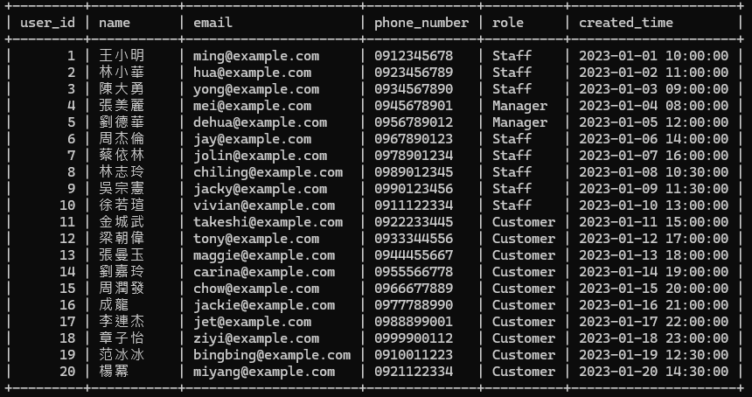
INSERT-Users

Slide 32
INSERT-Accounts
INSERT INTO Accounts (user_id, username, password) VALUES (1, 'ming123', '5e884898da28047151d0e56f8dc6292773603d0d6aabbdd62a11ef721d1542d8'), (2, 'hua456', 'a665a45920422f9d417e4867efdc4fb8a04a1f3fff1fa07e998e86f7f7a27ae3'), (3, 'yong789', 'd7a8fbb307d7809469ca9abcb0082e4f8d5651e46d3cdb762d02d0bf37c9e592'), (4, 'mei012', '2cf24dba5fb0a30e26e83b2ac5b9e29e1b161e5c1fa7425e73043362938b9824'), (5, 'dehua345', 'ef2d127de37b942baad06145e54b0c619a1f22327b2ebbcfbec78f5564afe39d'), (6, 'jay678', 'f2ca1bb6c7e907d06dafe4687e579fce76b37e4e93b7605022da52e6ccc26fd2'), (7, 'jolin901', '6b86b273ff34fce19d6b804eff5a3f5747ada4eaa22f1d49c01e52ddb7875b4b'), (8, 'chiling234', 'd4735e3a265e16eee03f59718b9b5d03019c07d8b6c51f90da3a666eec13ab35'), (9, 'jacky567', '4e07408562bedb8b60ce05c1decfe3ad16b72230967de01f640b7e4729b49fce'), (10, 'vivian890', '4b227777d4dd1fc61c6f884f48641d02b4d121d3fd328cb08b5531fcacdabf8a'), (11, 'takeshi123', 'ef2d127de37b942baad06145e54b0c619a1f22327b2ebbcfbec78f5564afe39d'), (12, 'tony456', '7902699be42c8a8e46fbbb4501726517e86b22c56a189f7625a6da49081b2451'), (13, 'maggie789', '2c26b46b68ffc68ff99b453c1d30413413422d706483bfa0f98a5e886266e7ae'), (14, 'carina012', 'fcde2b2edba56bf408601fb721fe9b5c338d10ee429ea04fae5511b68fbf8fb9'), (15, 'chow345', 'b94d27b9934d3e08a52e52d7da7dabfac484efe37a5380ee9088f7ace2efcde9'), (16, 'jackie678', 'c0535e4be2b79ffd93291305436bf889314e4a3faec05ecffcbb7df31ad9e51a'), (17, 'jet901', '6b51d431df5d7f141cbececcf79edf3dd861c3b4069f0b11661a3eefacbba918'), (18, 'ziyi234', '9f86d081884c7d659a2feaa0c55ad015a3bf4f1b2b0b822cd15d6c15b0f00a08'), (19, 'bingbing567', '8d969eef6ecad3c29a3a629280e686cf0c3f5d5a86aff3ca12020c923adc6c92'), (20, 'miyang890', '15e2b0d3c33891ebb0f1ef609ec419420c20e320ce94c65fbc8c3312448eb225');

Slide 33
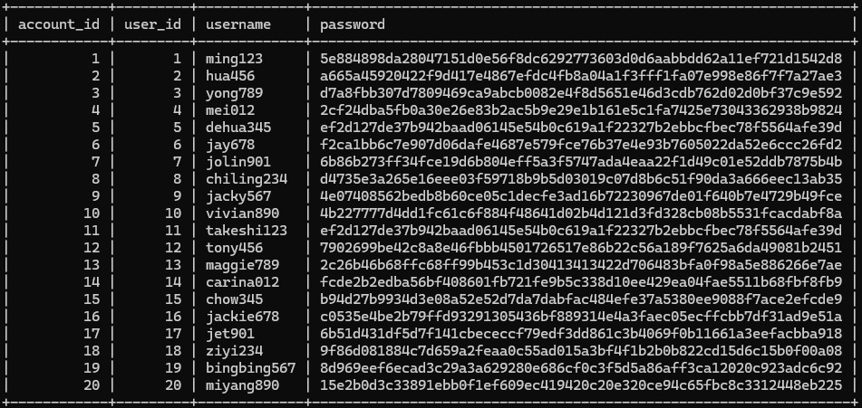
INSERT-Accounts

Slide 34
INSERT-Tables
INSERT INTO Tables ( table_number, capacity, status) VALUES (1, 4, 'Available'), (2, 4, 'Available'), (3, 6, 'Available'), (4, 6, 'Available'), (5, 8, 'Available'), (6, 2, 'Occupied'), (7, 2, 'Occupied'), (8, 4, 'Reserved'), (9, 4, 'Reserved'), (10, 6, 'Available'), (11, 6, 'Available'), (12, 8, 'Available'), (13, 10, 'Available'), (14, 10, 'Available'), (15, 12, 'Available'), (16, 2, 'Occupied'), (17, 4, 'Occupied'), (18, 6, 'Reserved'), (19, 8, 'Available'), (20, 10, 'Available'),
(21, 4, 'Available'),
(22, 6, 'Available'),
(23, 8, 'Available'),
(24, 10, 'Available'),
(25, 12, 'Available');

Slide 35
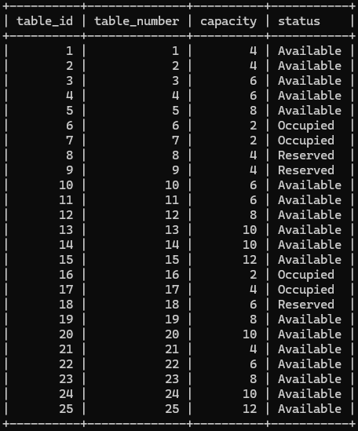
INSERT-Tables

Slide 36
INSERT-Menu_Categories
INSERT INTO Menu_Categories (category_name) VALUES ('前菜'), ('湯品'), ('主菜'), ('海鮮'), ('素食'), ('甜點'), ('飲料'), ('酒精飲料'), ('兒童餐'), ( '套餐'), ('季節限定'), ('廚師推薦'), ('開胃菜'), ('沙拉'), ('麵食'), ('飯類'), ('披薩'), ('漢堡'), ('三明治'), ('早餐');

Slide 37
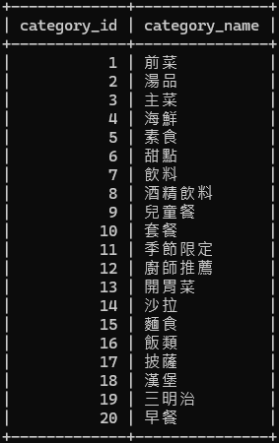
INSERT-Menu_Categories

Slide 38
INSERT-Menu_Items
INSERT INTO Menu_Items (category_id, item_name, description, price, availability) VALUES (1, '凱撒沙拉', '新鮮羅蔓生菜搭配凱撒醬', 180, 'Available'), (1, '洋蔥圈', '酥炸洋蔥圈', 120, 'Available'), (2, '玉米濃湯', '香濃玉米湯', 90, 'Available'), (2, '蘑菇濃湯', '新鮮蘑菇熬煮', 100, 'Available'), (3, '菲力牛排', '8oz 澳洲菲力', 580, 'Available'), (3, '肋眼牛排', '10oz 美國肋眼', 650, 'Available'), (4, '香煎鮭魚', '挪威鮭魚佐檸檬醬', 420, 'Available'), (4, '蒜香大蝦', '新鮮大蝦蒜香炒', 380, 'Available'), (5, '蔬菜千層麵', '多種蔬菜與起司', 320, 'Available'), (5, '蘑菇燉飯', '義大利米與綜合菇類', 280, 'Available'), (6, '提拉米蘇', '經典義式甜點', 150, 'Available'), (6, '巧克力熔岩', '熱巧克力蛋糕', 160, 'Available'), (7, '可樂', '冰涼可樂', 60, 'Available'), (7, '檸檬紅茶', '新鮮檸檬紅茶', 70, 'Available'), (8, '紅酒', 'House Wine', 180, 'Available'), (8, '啤酒', '台灣啤酒', 120, 'Available'), (9, '兒童餐', '雞塊+薯條+果汁', 200, 'Available'), (10, '商業午餐', '主菜+湯+飲料', 350, 'Available'), (11, '季節水果沙拉', '當季新鮮水果', 180, 'Out of Stock'), (12, '主廚特選', '每日主廚推薦', 450, 'Available');

Slide 39
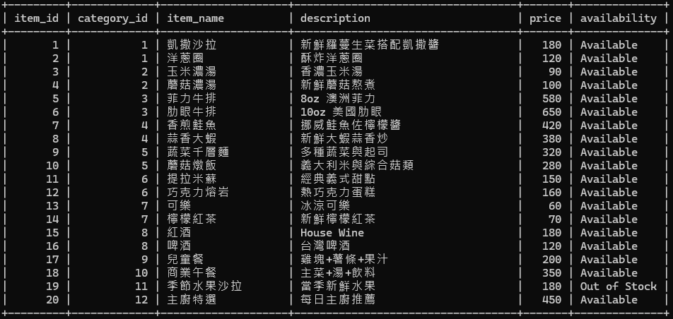
INSERT-Menu_Items

Slide 40
INSERT-Orders
INSERT INTO Orders ( user_id, table_id, order_status, order_time, total_price) VALUES (1, 1, 'Completed', '2023-02-01 12:00:00', 760), (2, 2, 'Completed', '2023-02-01 12:30:00', 920), (3, 3, 'Completed', '2023-02-01 13:00:00', 1240), (4, 4, 'Completed', '2023-02-02 11:30:00', 580), (5, 5, 'Completed', '2023-02-02 12:00:00', 1050), (6, 6, 'Completed', '2023-02-02 12:30:00', 680), (7, 7, 'Completed', '2023-02-03 13:00:00', 840), (8, 8, 'Completed', '2023-02-03 18:00:00', 960), (9, 9, 'Completed', '2023-02-03 18:30:00', 720), (10, 10, 'Completed', '2023-02-04 19:00:00', 1100), (11, 11, 'In Progress', '2023-02-04 19:30:00', 780), (12, 12, 'In Progress', '2023-02-05 12:00:00', 920), (13, 13, 'Pending', '2023-02-05 12:30:00', 640), (14, 14, 'Pending', '2023-02-05 13:00:00', 580), (15, 15, 'Cancelled', '2023-02-06 18:00:00', 0), (16, 16, 'Completed', '2023-02-06 18:30:00', 840), (17, 17, 'Completed', '2023-02-07 19:00:00', 960), (18, 18, 'Completed', '2023-02-07 19:30:00', 720), (19, 19, 'Completed', '2023-02-08 20:00:00', 1100), (20, 20, 'Completed', '2023-02-08 20:30:00', 780);

Slide 41
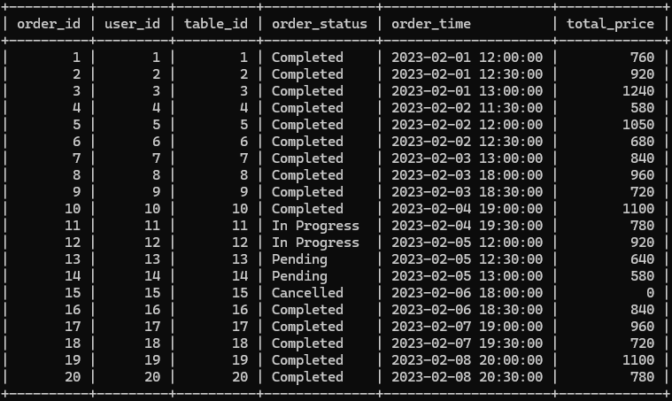
INSERT-Orders

Slide 42
INSERT-Order_Items
INSERT INTO Order_Items ( order_id, item_id, quantity) VALUES (1, 5, 1), (1, 15, 1), (2, 6, 1), (2, 16, 2), (3, 7, 2), (3, 8, 1), (4, 5, 1), (5, 6, 1), (5, 7, 1), (6, 9, 2), (6, 13, 2), (7, 10, 1), (7, 5, 1), (8, 6, 1), (8, 10, 1), (9, 7, 1), (9, 9, 1), (10, 5, 2), (11, 6, 1), (11, 7, 1),

Slide 43
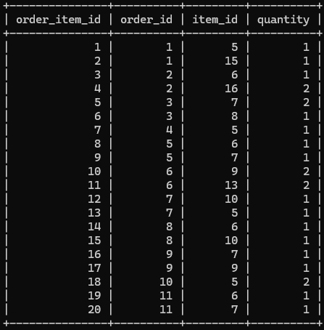
INSERT-Order_Items

Slide 44
INSERT-Reservations
INSERT INTO Reservations (user_id, table_id, reservation_time, status) VALUES (1, 1, '2023-03-01 12:00:00', 'Confirmed'), (2, 2, '2023-03-01 12:30:00', 'Confirmed'), (3, 3, '2023-03-01 13:00:00', 'Confirmed'), (4, 4, '2023-03-02 18:00:00', 'Confirmed'), (5, 5, '2023-03-02 18:30:00', 'Confirmed'), (6, 6, '2023-03-03 19:00:00', 'Confirmed'), (7, 7, '2023-03-03 19:30:00', 'Confirmed'), (8, 8, '2023-03-04 20:00:00', 'Confirmed'), (9, 9, '2023-03-04 20:30:00', 'Confirmed'), (10, 10, '2023-03-05 12:00:00', 'Confirmed'), (11, 11, '2023-03-05 12:30:00', 'Pending'), (12, 12, '2023-03-06 13:00:00', 'Pending'), (13, 13, '2023-03-06 18:00:00', 'Pending'), (14, 14, '2023-03-07 18:30:00', 'Pending'), (15, 15, '2023-03-07 19:00:00', 'Cancelled'), (16, 16, '2023-03-08 19:30:00', 'Confirmed'), (17, 17, '2023-03-08 20:00:00', 'Confirmed'), (18, 18, '2023-03-09 20:30:00', 'Confirmed'), (19, 19, '2023-03-10 12:00:00', 'Confirmed'), (20, 20, '2023-03-10 12:30:00', 'Confirmed');

Slide 45
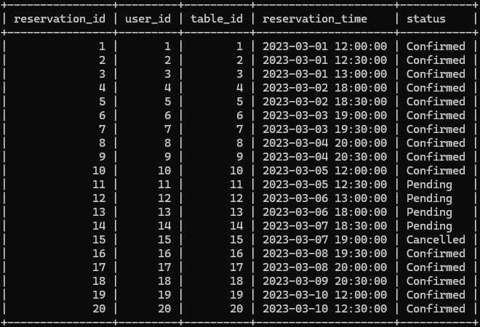
INSERT-Reservations

Slide 46
INSERT-Payments
INSERT INTO Payments ( order_id, payment_method, payment_status, payment_time) VALUES (1, 'Credit Card', 'Paid', '2023-02-01 12:30:00'), (2, 'Cash', 'Paid', '2023-02-01 13:00:00'), (3, 'online payment', 'Paid', '2023-02-01 13:30:00'), (4, 'Credit Card', 'Paid', '2023-02-02 12:00:00'), (5, 'Cash', 'Paid', '2023-02-02 12:30:00'), (6, 'online payment', 'Paid', '2023-02-02 13:00:00'), (7, 'Credit Card', 'Paid', '2023-02-03 13:30:00'), (8, 'Cash', 'Paid', '2023-02-03 18:30:00'), (9, 'online payment', 'Paid', '2023-02-03 19:00:00'), (10, 'Credit Card', 'Paid', '2023-02-04 19:30:00'), (11, 'Cash', 'Pending', NULL), (12, 'online payment', 'Pending', NULL), (13, 'Credit Card', 'Pending', NULL), (14, 'Cash', 'Pending', NULL), (15, 'online payment', 'Failed', '2023-02-06 18:15:00'), (16, 'Credit Card', 'Paid', '2023-02-06 19:00:00'), (17, 'Cash', 'Paid', '2023-02-07 19:30:00'), (18, 'online payment', 'Paid', '2023-02-07 20:00:00'), (19, 'Credit Card', 'Paid', '2023-02-08 20:30:00'), (20, 'Cash', 'Paid', '2023-02-08 21:00:00');

Slide 47
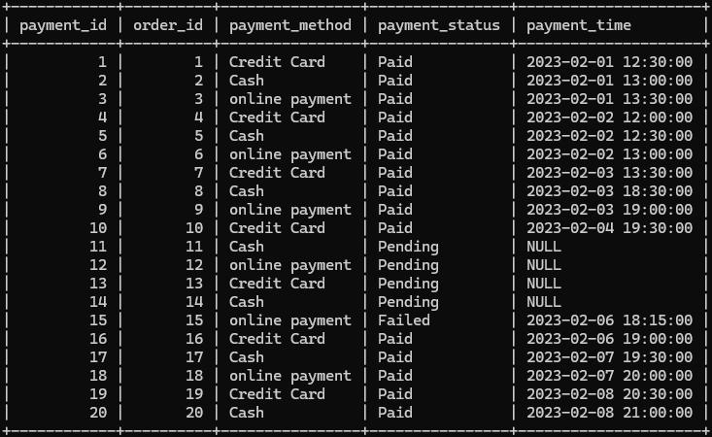
INSERT-Payments

Slide 48
INSERT-Staff
INSERT INTO Staff (user_id, position, salary, hire_date) VALUES (1, 'Waiter', 32000, '2022-01-15 09:00:00'), (2, 'Chef', 55000, '2021-11-20 08:30:00'), (3, 'Waiter', 30000, '2022-03-10 10:00:00'), (4, 'Manager', 45000, '2021-09-05 08:00:00'), (5, 'Manager', 31000, '2022-05-12 09:30:00'), (6, 'Waiter', 30500, '2022-06-18 10:00:00'), (7, 'Chef', 46000, '2021-08-22 08:00:00'), (8, 'Waiter', 31500, '2022-07-25 09:00:00'), (9, 'Waiter', 58000, '2021-07-15 08:30:00'), (10, 'Chef', 47000, '2021-10-30 08:00:00'),

Slide 49
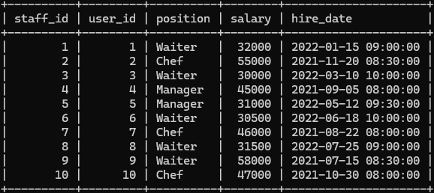
INSERT-Staff

Slide 50
INSERT-Attendance
INSERT INTO Attendance (staff_id, check_in_time, check_out_time) VALUES (1, '2023-02-01 08:00:00', '2023-02-01 17:00:00'), (2, '2023-02-01 08:30:00', '2023-02-01 18:00:00'), (3, '2023-02-01 09:00:00', '2023-02-01 17:30:00'), (4, '2023-02-01 07:30:00', '2023-02-01 16:30:00'), (5, '2023-02-01 08:00:00', '2023-02-01 17:00:00'), (6, '2023-02-01 09:00:00', '2023-02-01 18:00:00'), (7, '2023-02-01 07:00:00', '2023-02-01 16:00:00'), (8, '2023-02-01 08:30:00', '2023-02-01 17:30:00'), (9, '2023-02-01 08:00:00', '2023-02-01 18:00:00'), (10, '2023-02-01 07:30:00', '2023-02-01 16:30:00'), (11, '2023-02-02 08:00:00', '2023-02-02 17:00:00'), (12, '2023-02-02 09:00:00', '2023-02-02 18:00:00'), (13, '2023-02-02 07:30:00', '2023-02-02 16:30:00'), (14, '2023-02-02 08:00:00', '2023-02-02 17:00:00'), (15, '2023-02-02 08:30:00', '2023-02-02 18:00:00'), (16, '2023-02-02 07:00:00', '2023-02-02 16:00:00'), (17, '2023-02-02 08:00:00', '2023-02-02 17:30:00'), (18, '2023-02-02 09:00:00', '2023-02-02 18:00:00'), (19, '2023-02-02 07:30:00', '2023-02-02 16:30:00'), (20, '2023-02-02 08:00:00', '2023-02-02 17:00:00');

Slide 51
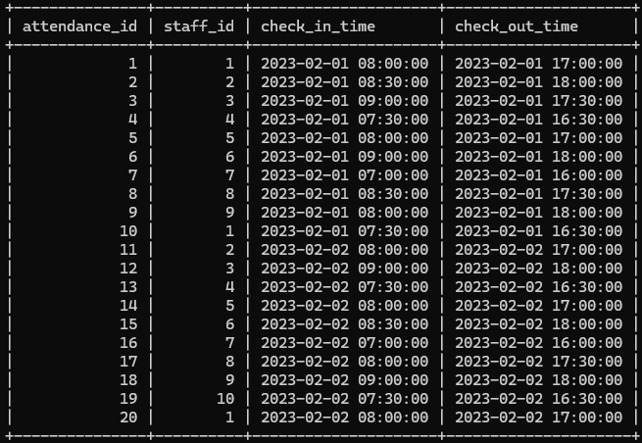
INSERT-Attendance

Slide 52
INSERT-Suppliers
INSERT INTO Suppliers (supplier_name, contact_info, address) VALUES ('台灣農產', '02-12345678', '台北市中山區農安街100號'), ('海鮮大王', '02-23456789', '台北市萬華區華西街200號'), ('肉品專家', '02-34567890', '新北市三重區重新路三段300號'), ('冷凍食品', '02-45678901', '新北市中和區中山路二段400號'), ('飲料供應商', '02-56789012', '桃園市桃園區中正路500號'), ('調味料專賣', '03-12345678', '新竹市東區光復路一段600號'), ('蔬菜直送', '03-23456789', '苗栗縣苗栗市中山路700號'), ('水果批發', '04-12345678', '台中市西區公益路800號'), ('烘焙原料', '04-23456789', '台中市北區三民路三段900號'), ('有機食品', '05-12345678', '台南市東區崇學路1000號'), ('進口食材', '05-23456789', '台南市安平區永華路二段1100號'), ('乳製品供應', '06-12345678', '高雄市前金區成功一路1200號'), ('米糧批發', '06-23456789', '高雄市苓雅區四維三路1300號'), ('香料專賣', '07-12345678', '屏東市中山路1400號'), ('酒類供應', '07-23456789', '宜蘭縣宜蘭市中山路五段1500號'), ('咖啡豆專賣', '08-12345678', '花蓮縣花蓮市中山路1600號'), ('茶葉供應', '08-23456789', '台東縣台東市中山路1700號'), ('有機蔬菜', '049-123456', '南投縣草屯鎮中正路1800號'), ('海鮮批發', '049-234567', '彰化縣彰化市中正路二段1900號'), ('肉品批發', '049-345678', '雲林縣斗六市中山路2000號');

Slide 53
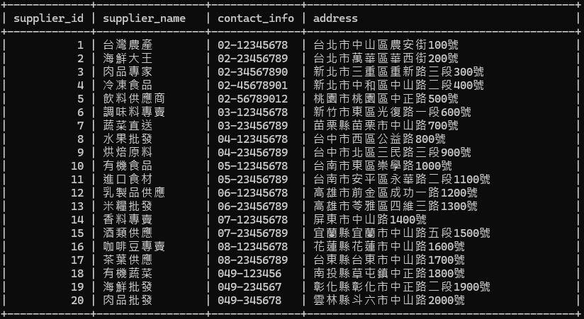
INSERT-Suppliers

Slide 54
INSERT-Inventory
INSERT INTO Inventory (item_name, stock_quantity, supplier_id, last_checker) VALUES ('牛肉', 50, 3, 1), ('豬肉', 60, 3, 5), ('雞肉', 70, 3, 1), ('鮭魚', 30, 2, 8), ('蝦仁', 40, 2, 7), ('生菜', 100, 1, 2), ('番茄', 80, 1, 8), ('洋蔥', 90, 1, 5), ('蘑菇', 60, 1, 10), ('義大利麵', 50, 2), ('米', 200, 13, 3), ('起司', 40, 12, 3), ('奶油', 30, 12, 4), ('牛奶', 50, 12, 5), ('咖啡豆', 20, 16, 7), ('茶葉', 30, 17, 7), ('紅酒', 40, 15, 2), ('啤酒', 60, 5, 2), ('可樂', 100, 5, 3), ('檸檬', 50, 7, 3),
('糖', 30, 6, 3),
('鹽', 40, 6, 3),
('胡椒', 30, 14, 4),
('橄欖油', 20, 6, 4),
('麵粉', 50, 9, 4);

Slide 55
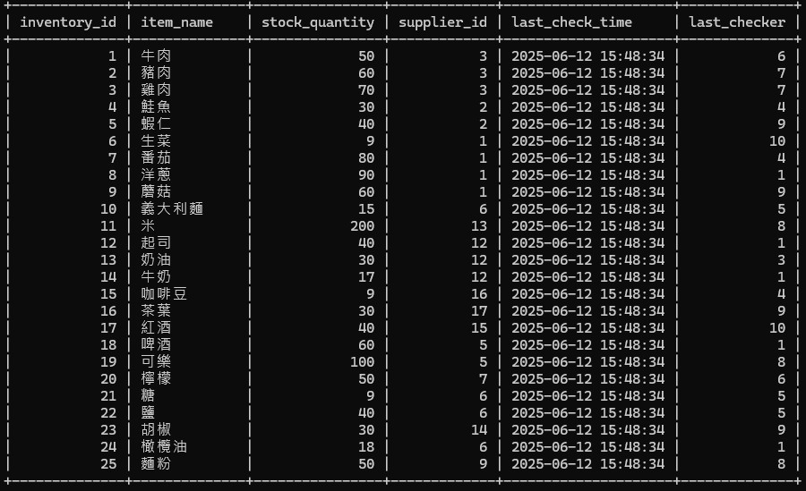
INSERT-Inventory

Slide 56
View

Slide 57
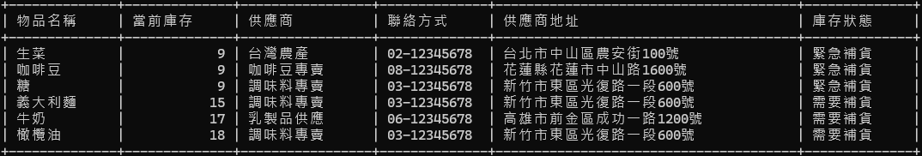
View-庫存預警
CREATE VIEW Low_Stock_Alert AS SELECT i.item_name AS 物品名稱, i.stock_quantity AS 當前庫存, s.supplier_name AS 供應商, s.contact_info AS 聯絡方式, s.address AS 供應商地址, CASE WHEN i.stock_quantity < 10 THEN '緊急補貨' WHEN i.stock_quantity < 20 THEN '需要補貨' ELSE '庫存充足' END AS 庫存狀態 FROM Inventory i JOIN Suppliers s ON i.supplier_id = s.supplier_id WHERE i.stock_quantity < 20 ORDER BY i.stock_quantity ASC;

Slide 58
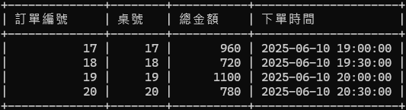
View-今日訂單總覽
CREATE VIEW Today_Orders_Summary AS SELECT o.order_id AS 訂單編號, t.table_number AS 桌號, o.total_price AS 總金額, o.order_time AS 下單時間 FROM Orders o JOIN Tables t ON o.table_id = t.table_id WHERE DATE(o.order_time) = CURDATE() GROUP BY o.order_id ORDER BY o.order_id ASC;

Slide 59
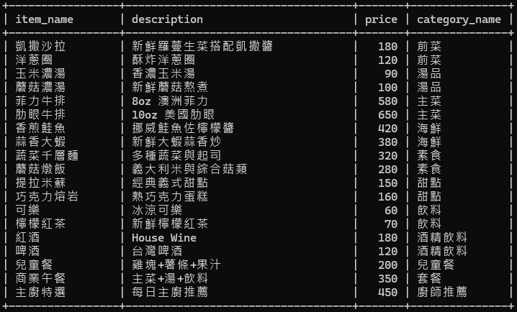
View-菜單總覽
CREATE VIEW Menu AS SELECT mi.item_name, mi.description, mi.price, mc.category_name FROM Menu_Items mi JOIN Menu_Categories mc ON mi.category_id = mc.category_id WHERE mi.availability = 'Available';

Slide 60
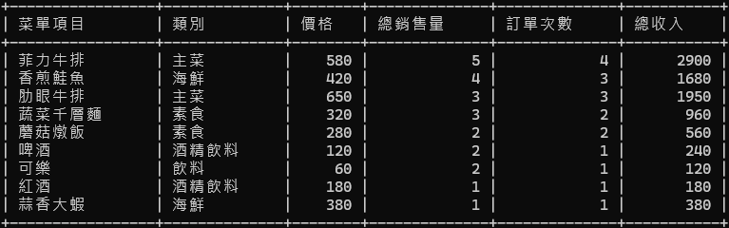
View-熱門菜單項目
CREATE VIEW Popular_Menu_Items AS SELECT mi.item_name AS 菜單項目, mc.category_name AS 類別, mi.price AS 價格, SUM(oi.quantity) AS 總銷售量, COUNT(DISTINCT o.order_id) AS 訂單次數, (SUM(oi.quantity) * mi.price) AS 總收入 FROM Menu_Items mi JOIN Menu_Categories mc ON mi.category_id = mc.category_id JOIN Order_Items oi ON mi.item_id = oi.item_id JOIN Orders o ON oi.order_id = o.order_id WHERE o.order_status = 'Completed' GROUP BY mi.item_id ORDER BY 總銷售量 DESC LIMIT 10;

Slide 61
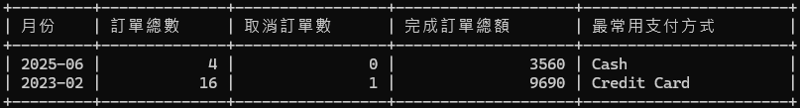
View-每月銷售報表
CREATE VIEW Monthly_Sales_Report AS SELECT DATE_FORMAT(o.order_time, '%Y-%m') AS 月份, COUNT(o.order_id) AS 訂單總數, (SELECT COUNT(*) FROM Orders WHERE order_status = 'Cancelled' AND DATE_FORMAT(order_time, '%Y-%m') = DATE_FORMAT(o.order_time, '%Y-%m')) AS 取消訂單數, (SELECT SUM(total_price) FROM Orders WHERE order_status = 'Completed' AND DATE_FORMAT(order_time, '%Y-%m') = DATE_FORMAT(o.order_time, '%Y-%m')) AS 完成訂單總額, ( SELECT p.payment_method FROM Payments p JOIN Orders o2 ON p.order_id = o2.order_id WHERE DATE_FORMAT(o2.order_time, '%Y-%m') = DATE_FORMAT(o.order_time, '%Y-%m') GROUP BY p.payment_method ORDER BY COUNT(p.payment_id) DESC LIMIT 1 ) AS 最常用支付方式 FROM Orders o GROUP BY DATE_FORMAT(o.order_time, '%Y-%m') ORDER BY 月份 DESC;

Slide 62
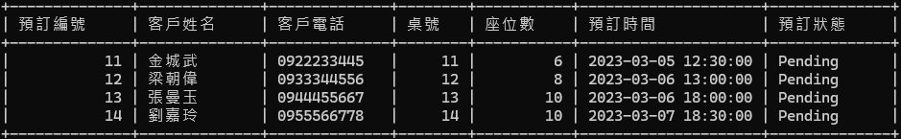
View-待處理訂位
CREATE VIEW Pending_Reservations_View AS SELECT r.reservation_id AS 預訂編號, u.name AS 客戶姓名, u.phone_number AS 客戶電話, t.table_number AS 桌號, t.capacity AS 座位數, r.reservation_time AS 預訂時間, r.status AS 預訂狀態 FROM Reservations r JOIN Users u ON r.user_id = u.user_id JOIN Tables t ON r.table_id = t.table_id WHERE r.status = 'Pending' ORDER BY r.reservation_time ASC;

Slide 63
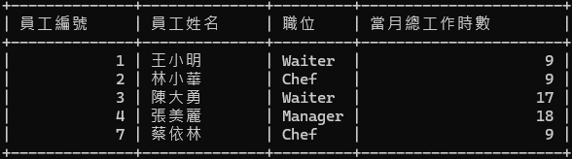
View-員工月出勤時數
CREATE OR REPLACE VIEW Staff_Monthly_Hours AS SELECT s.staff_id AS 員工編號, u.name AS 員工姓名, s.position AS 職位, SUM(TIMESTAMPDIFF(HOUR, a.check_in_time, a.check_out_time)) AS 當月總工作時數 FROM Staff s JOIN Users u ON s.user_id = u.user_id JOIN Attendance a ON s.staff_id = a.staff_id WHERE YEAR(a.check_in_time) = YEAR(CURRENT_DATE) AND MONTH(a.check_in_time) = MONTH(CURRENT_DATE) GROUP BY s.staff_id, u.name, s.position ORDER BY s.staff_id;

Slide 64
View-待處理訂單
CREATE VIEW Pending_Orders_View AS SELECT o.order_id AS 訂單編號, t.table_number AS 桌號, o.order_time AS 下單時間, o.total_price AS 總金額, GROUP_CONCAT(mi.item_name SEPARATOR ', ') AS 餐點項目, o.order_status AS 訂單狀態 FROM Orders o JOIN Tables t ON o.table_id = t.table_id JOIN Order_Items oi ON o.order_id = oi.order_id JOIN Menu_Items mi ON oi.item_id = mi.item_id WHERE o.order_status IN ('Pending', 'In Progress') GROUP BY o.order_id ORDER BY o.order_time;

Slide 65
心得報告

Slide 66
胡晉嘉
張鈞凱
這次餐廳管理系統的資料庫專題讓我獲益良多。從最初的系統需求分析開始，我逐步完成了ER diagram的規劃設計，深入理解了資料庫完整性限制的重要性。在實際建置資料表的過程中，我特別注重主鍵與外鍵的約束關係，並透過各種驗證方式確保每個欄位的完整性限制都能正確運作。此外，我還學習了如何建立view來簡化複雜查詢。這次實作讓我深刻體會到，要設計出一個完善的資料庫系統，要對每個細節都嚴格把關，任何一個小疏忽都可能影響整體資料的完整性與正確性。
這是我第一次建立資料庫，這次期末專題讓我深知了解到創建table、insert和各式view，我也從一開始使用command promt到載DBeaver來用GUI來更好看出目前的資料庫狀態，途中也有遇到各式各樣的問題像是因為在insert dummy data不夠謹慎導致view的輸出有邏輯上的錯誤，也讓我認識到了資料的完整性有多重要，可以省去在輸入資料時的錯誤，也意識到資料庫完整創建的重要性，可以省去後續實作的複雜度。
。
林震宇
楊政愷
在建立餐廳資料庫系統的過程中，我覺得需要貼近實際營運流程的理解。結合我在餐飲業工作的經驗，像是訂單處理、菜單更新、庫存管理與顧客訂位這幾個環節在系統設計中的重要性。透過這次設計，我學會了運用檢查條件與觸發器來防止異常輸入。同時，ER圖幫助我在系統分析階段快速釐清各項資源與流程間的邏輯關係，使得整個資料架構更為清晰與完整。這次經驗讓我學會了提升效率與服務品質上的關鍵作用，也讓我更有信心將實務經驗轉化為具體的技術解決方案。
完成餐廳管理系統資料庫設計後，我感受到資料庫結構對系統效率與資料完整性的重要性。透過設計Users、Orders、Inventory等資料表，我學會如何運用主鍵、外鍵與檢查約束確保資料一致性，並利用視圖簡化邏輯與查詢。ER圖讓我更清晰掌握實體關係，特別是在處理多對多關係時。模擬真實資料的過程也讓我意識到實際應用中資料的複雜性與多樣性。這次不僅提升了我的SQL技能，也讓我對系統分析與需求轉化有了更深的理解。

Slide 67
工作分配

Slide 68
胡晉嘉
張鈞凱
Schema設計-25%
ER-Diagram繪製-25%
View建置-25%
資料輸入-25%
PPT製作-100%
系統安裝-25%
資料庫建置-50%
Schema設計-25%
ER-Diagram繪製-50%
View建置-75%
。
林震宇
楊政愷
資料庫建置-25%
Schema設計-25%
ER-Diagram繪製-25%
資料輸入-50%
Word製作-75%
系統安裝-75%
資料庫建置-25%
Schema設計-25%
資料輸入-25%
Word製作-25%

Slide 69


謝謝大家
餐廳管理系統

